Slide 1



Report on Credit Card Fraud Detection
This comprehensive report presents the problem statement, data sources, project objectives, and the rigorous methodology employed. It also offers valuable insights into the prevalence of credit card fraud and its significant impact on the banking industry.
By:
Trapti Agarwal
.

Slide 2
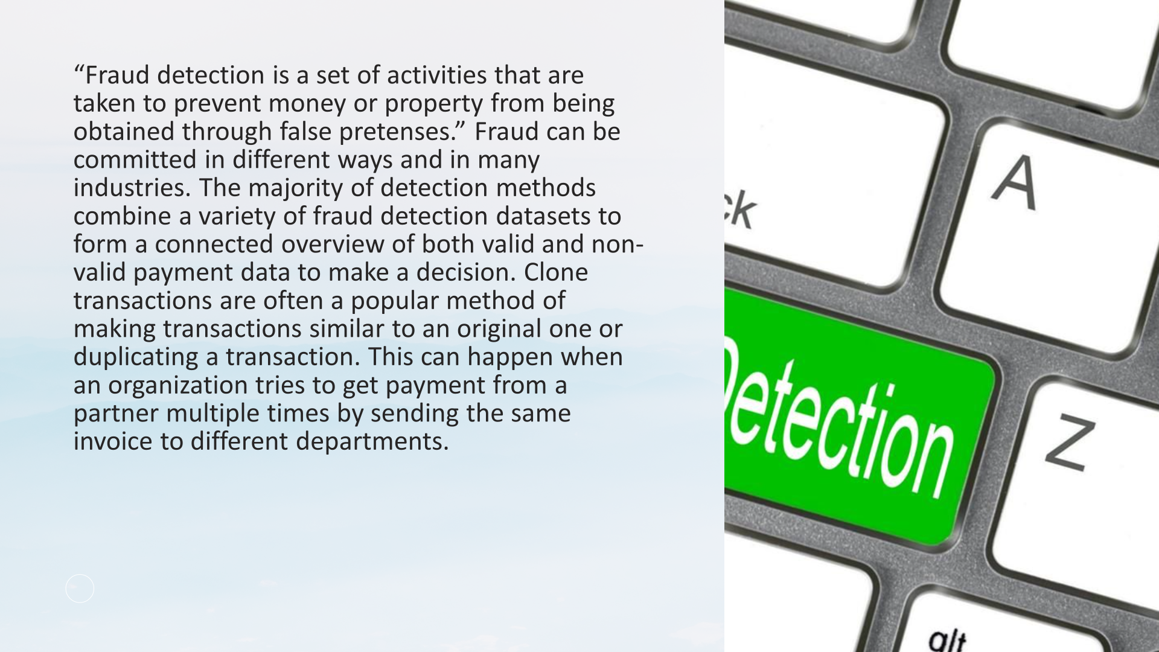


Slide 3
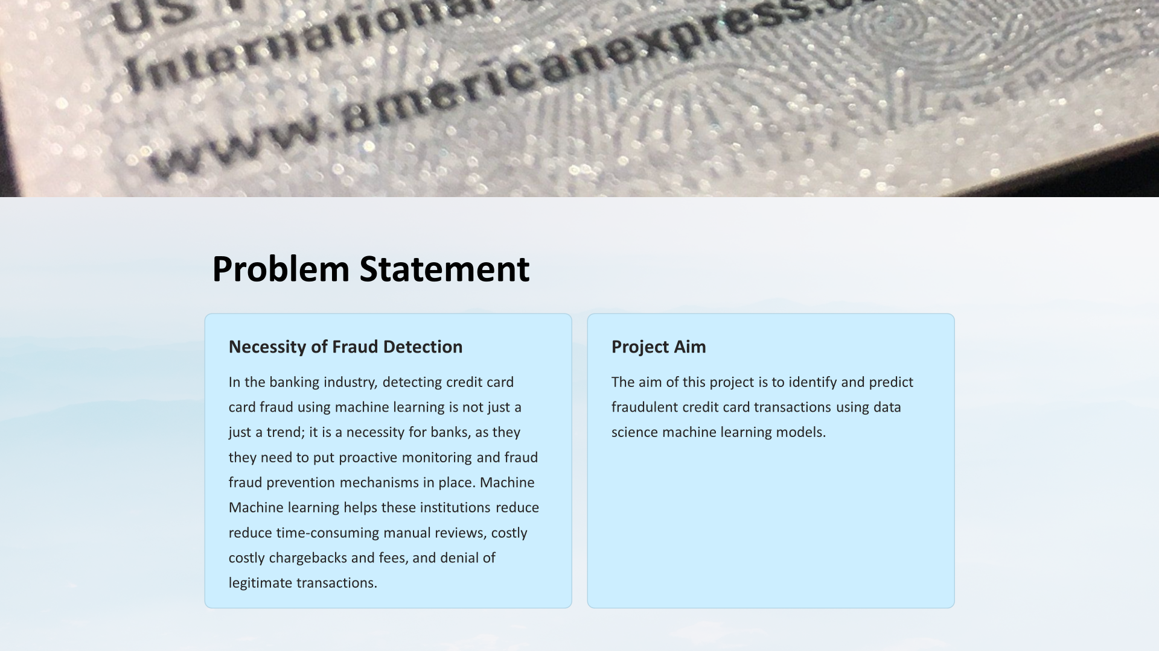

Slide 4
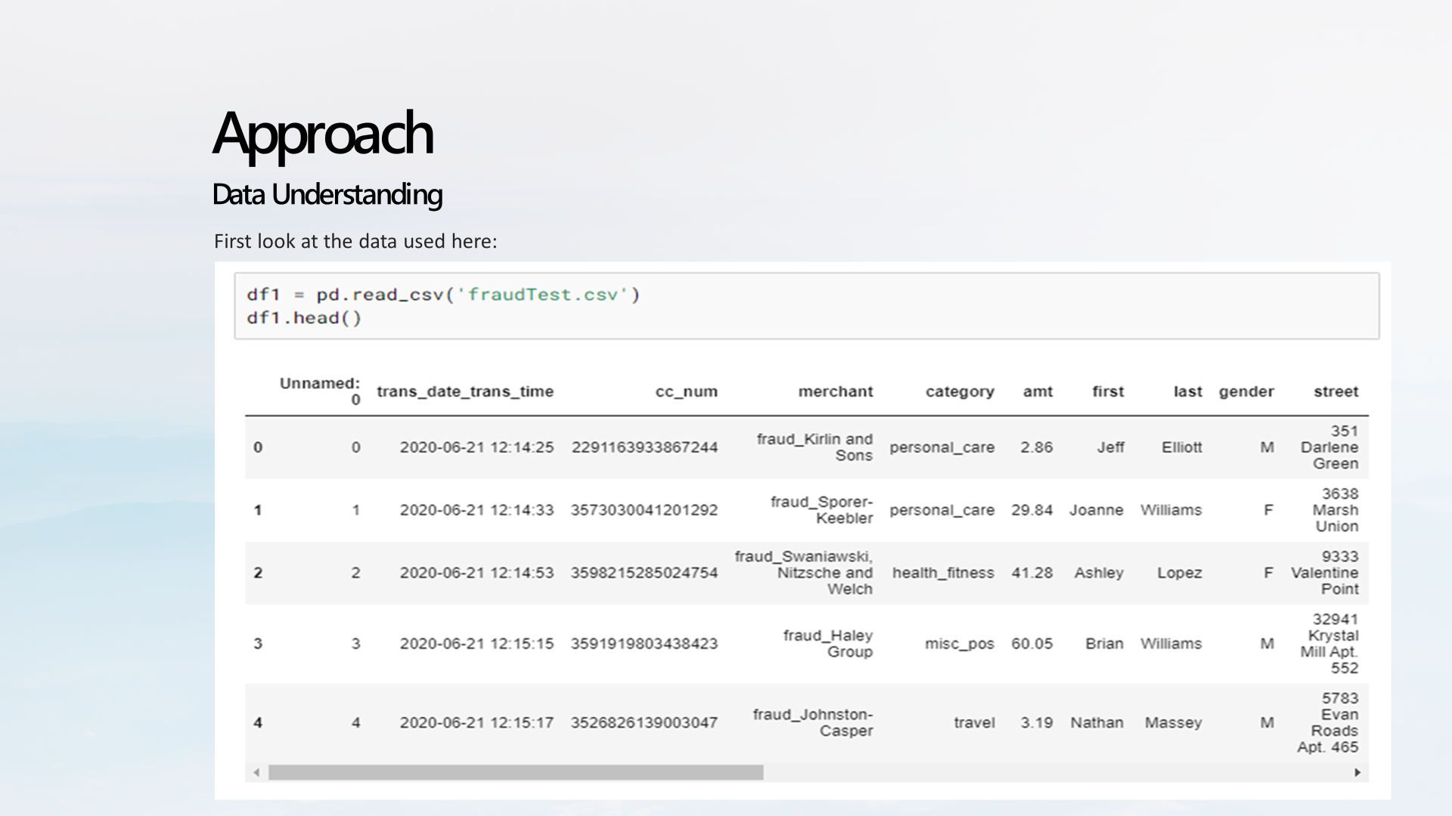

Slide 5
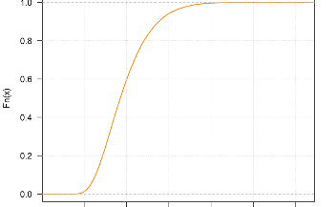
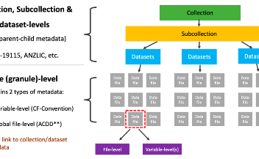
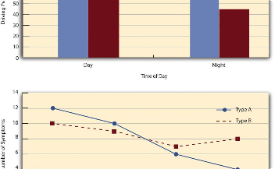
Data Exploration
Data Distribution
Data Quality
Relationship Between Variables
The report explores the data set, which contains 1.85 million transactions from 2019 and 2020, with 22 features and a binary target variable indicating fraud or not. It performs some descriptive statistics, data cleaning, and data visualization to understand the data distribution, the data quality, and the relationship between the variables.

Slide 6
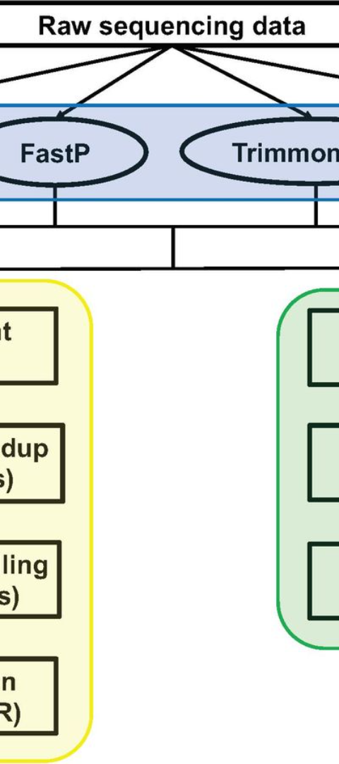
Data Preprocessing:
Categorical Variables
Date and Time Features
The report performs some data preprocessing steps, such as converting categorical variables dummy variables.
The report creates new features based on the date and time of the transactions.
Numerical Variables
The report scale the numerical variables using standardization.

Slide 7
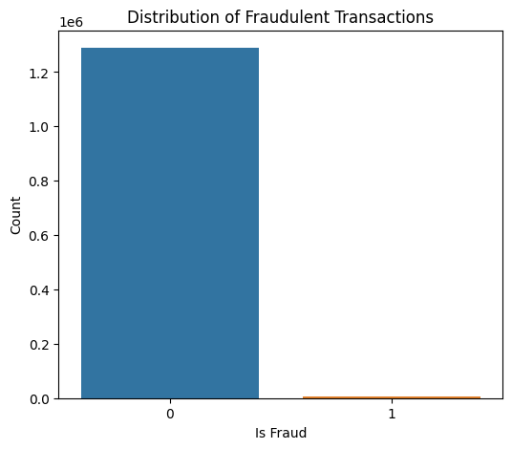
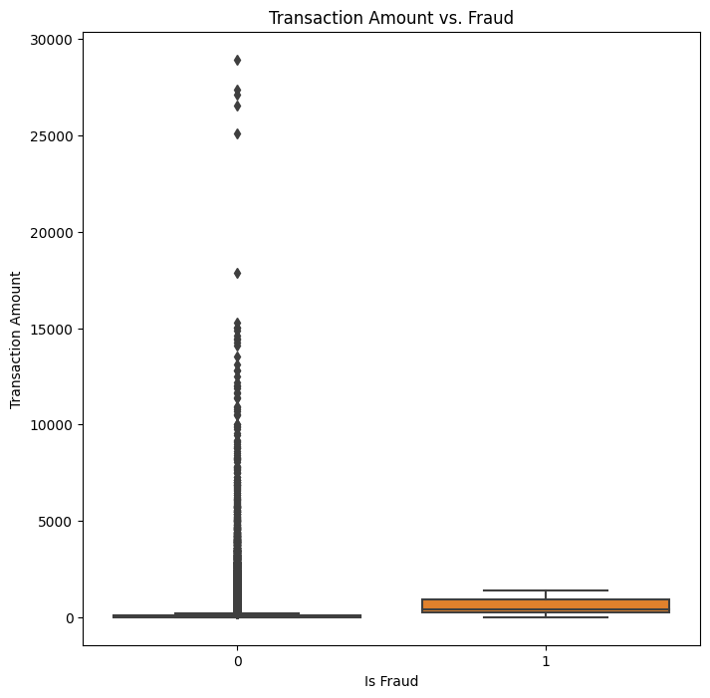

Slide 8
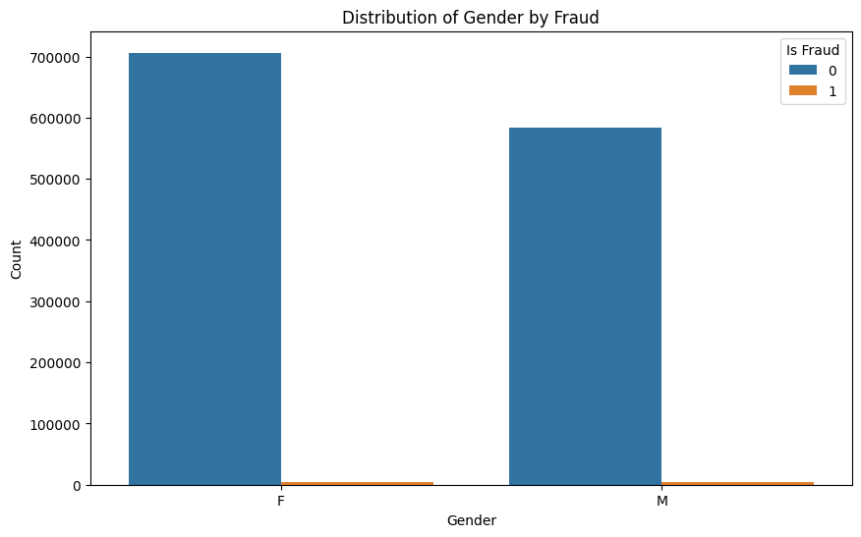
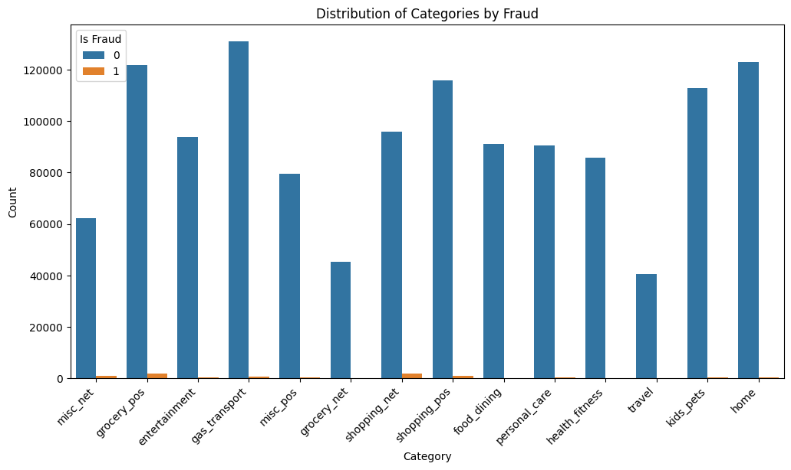

Slide 9
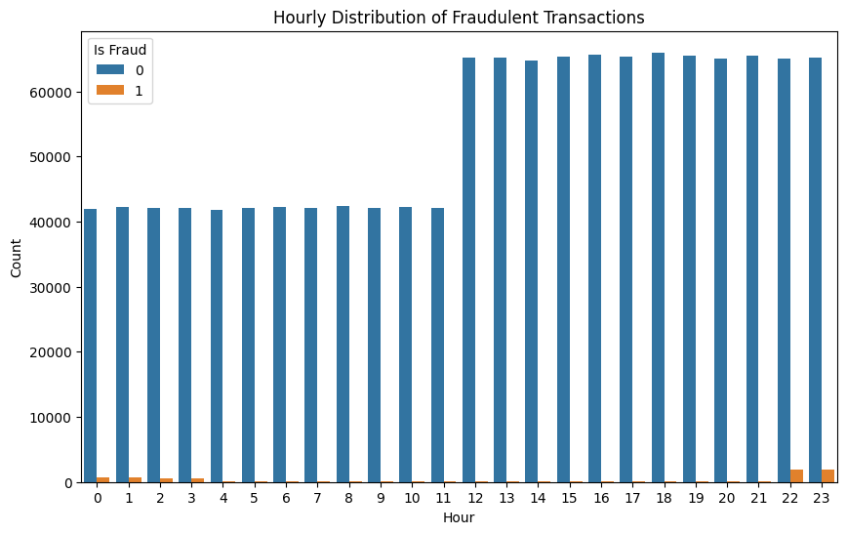
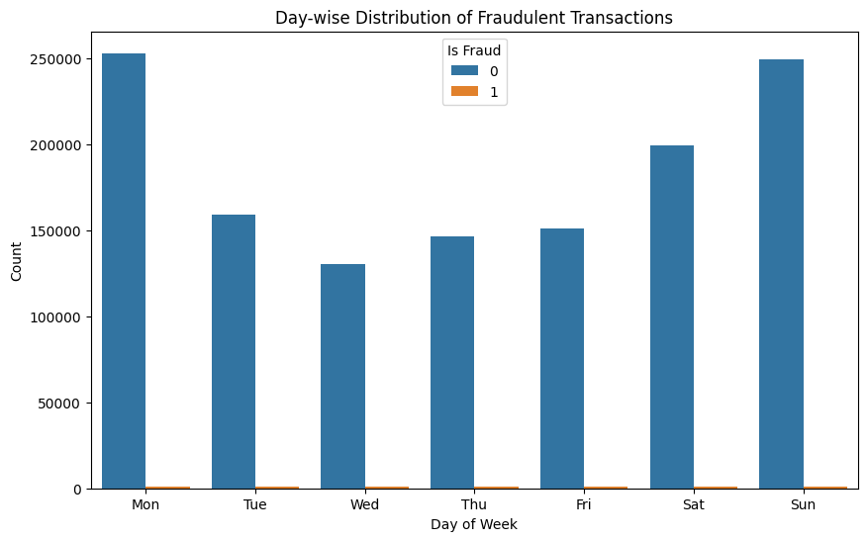

Slide 10
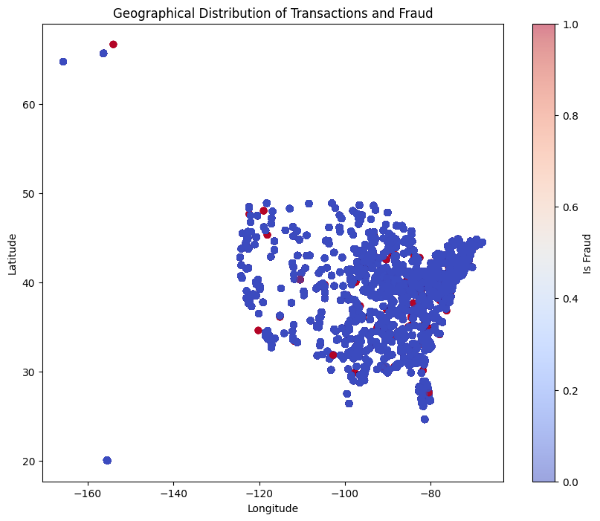
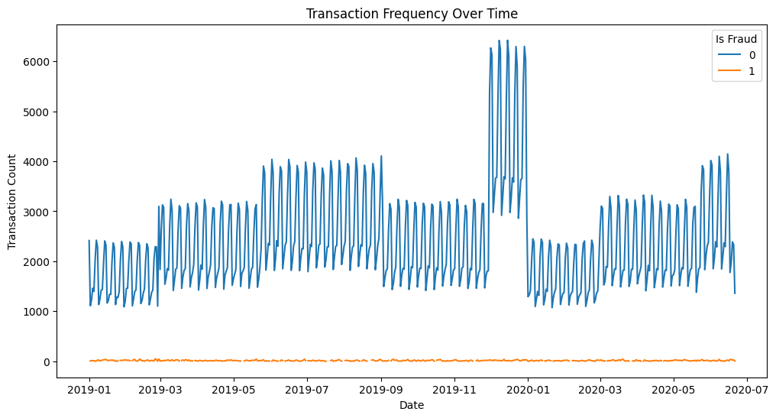

Slide 11
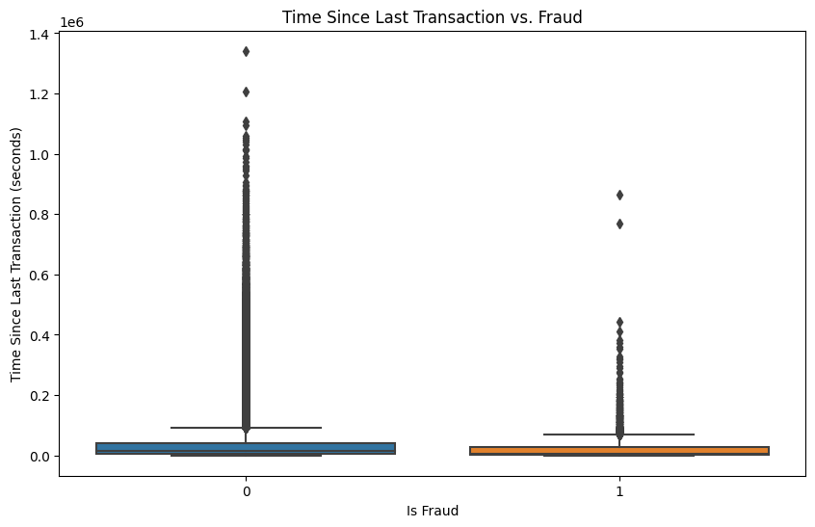
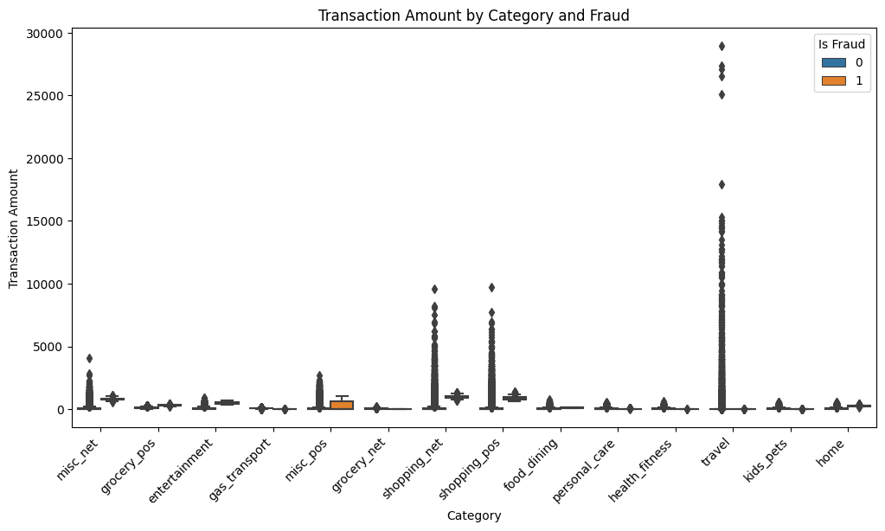

Slide 12
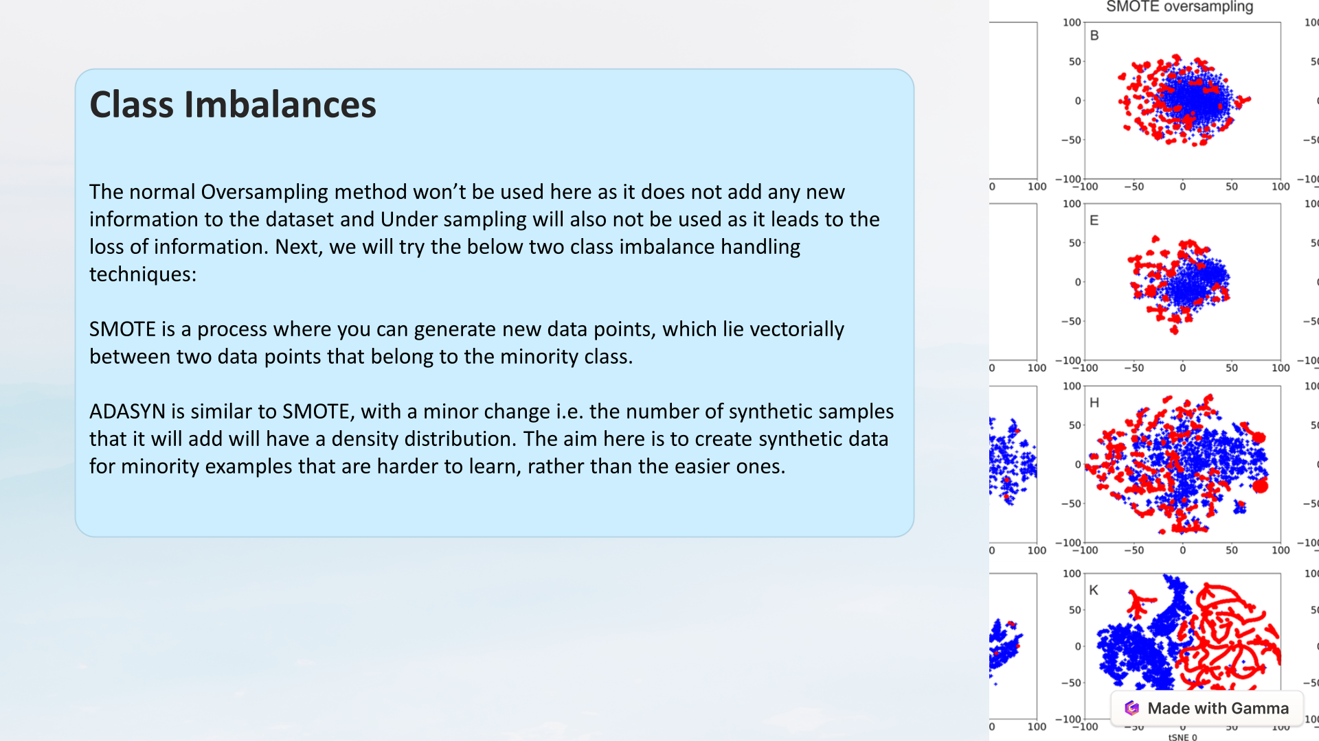

Slide 13
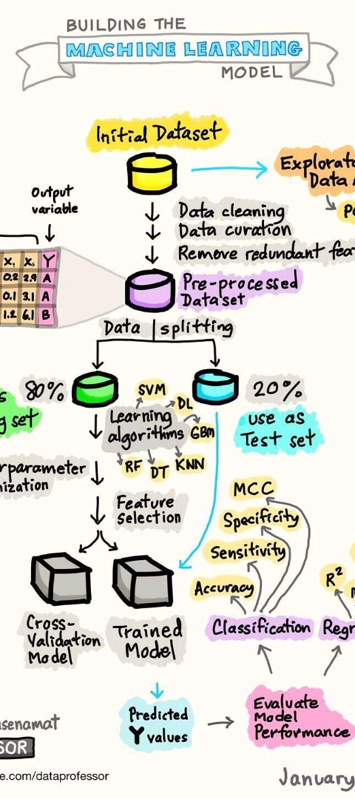
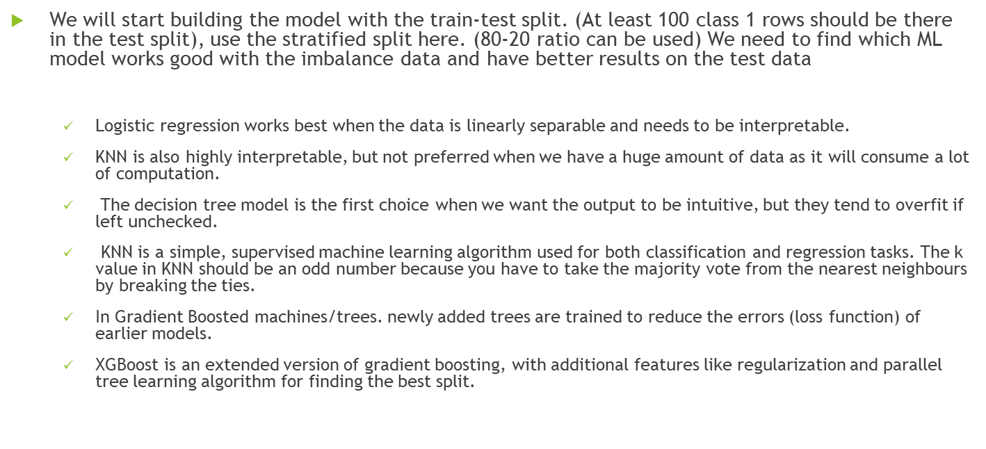
Model Selection:

Slide 14

Model Building
1
The report builds and compares three machine learning models: logistic regression, decision tree, and random forest. It uses accuracy, precision, recall, f1-score, and ROC curve as the evaluation metrics. It also performs grid search and cross-validation to tune the hyperparameters of the models.
We will start with the Logistic regression model with the different value of regularization and hyper param tuning, then go to the decision tree and so on etc. We will also try ensemble models and use voting classifier, Bagging, Boosting etc. on the best performing individual models to find the best model.
Logistic Regression
2
Decision Tree
3
Random Forest

Slide 15
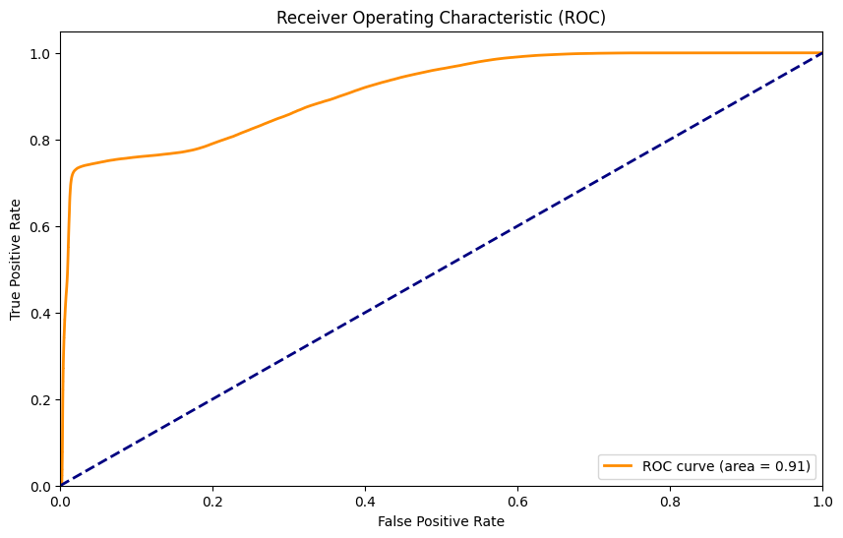
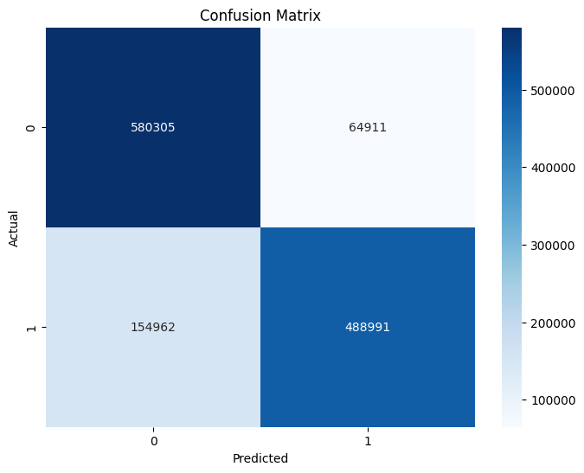

Slide 16


Slide 17


Slide 18


Slide 19
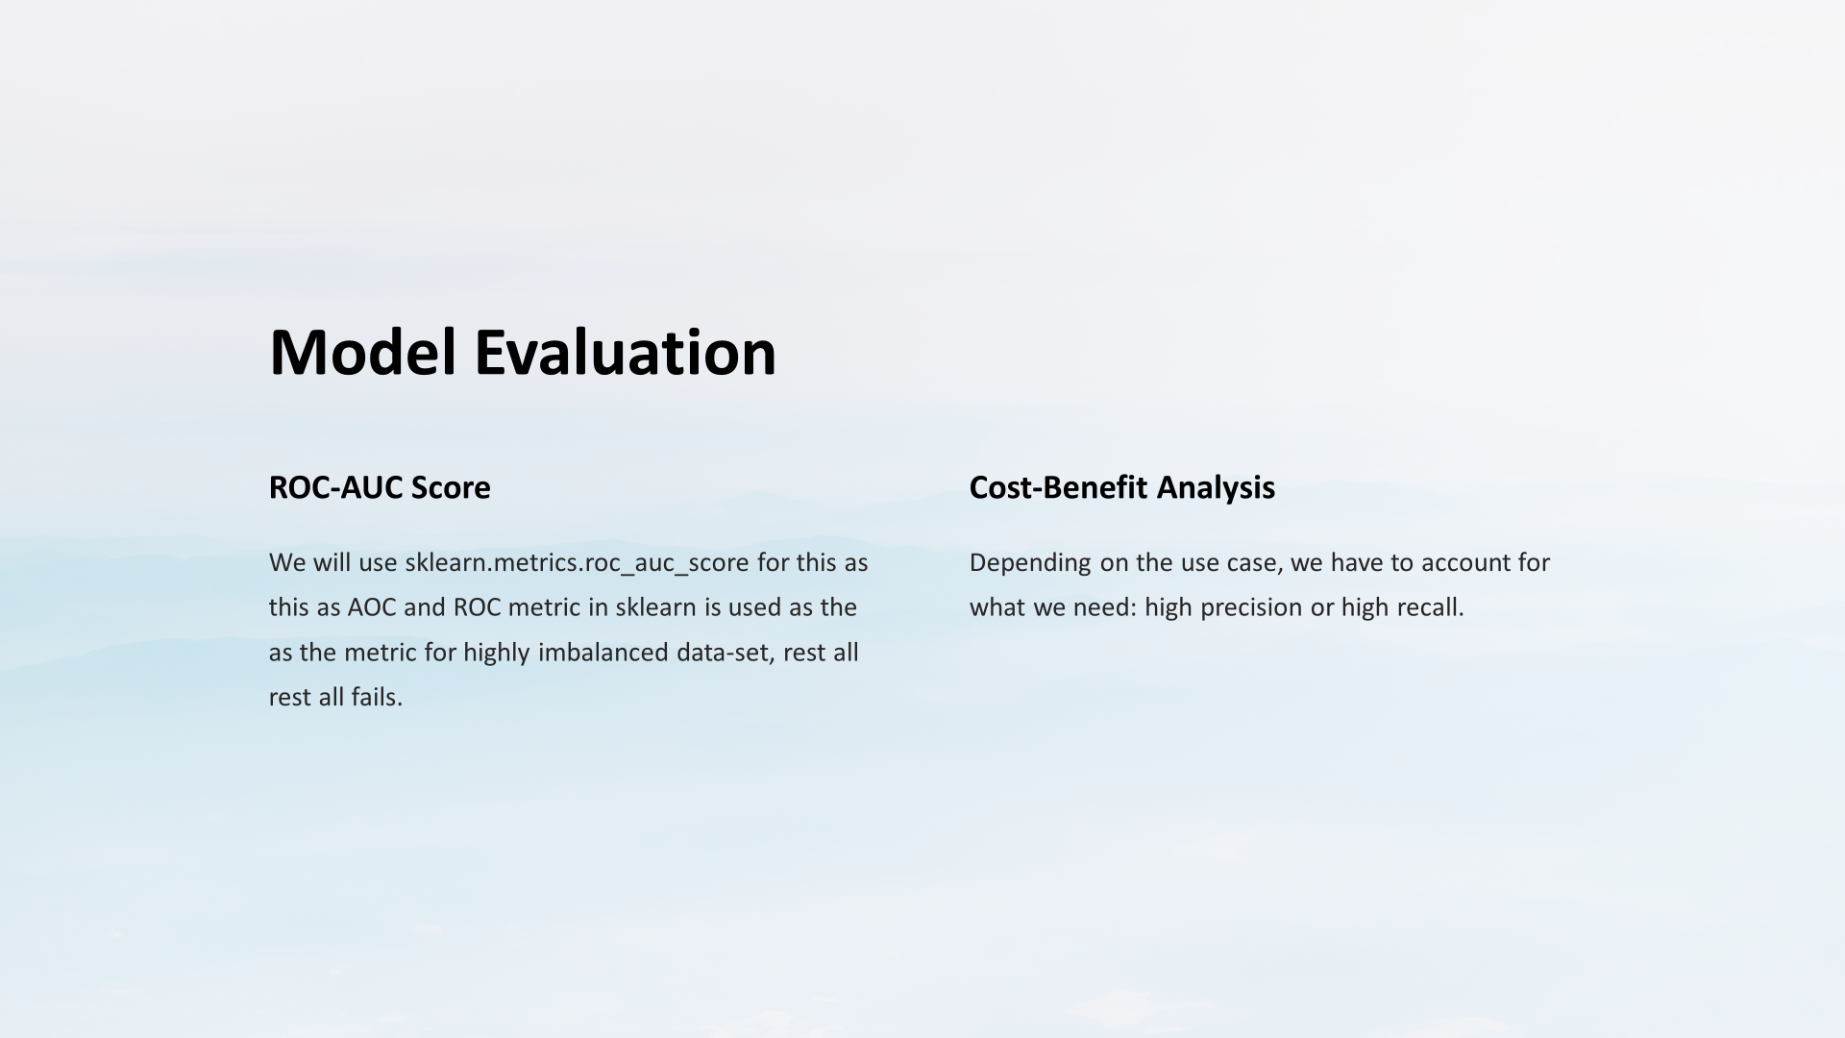


Slide 20
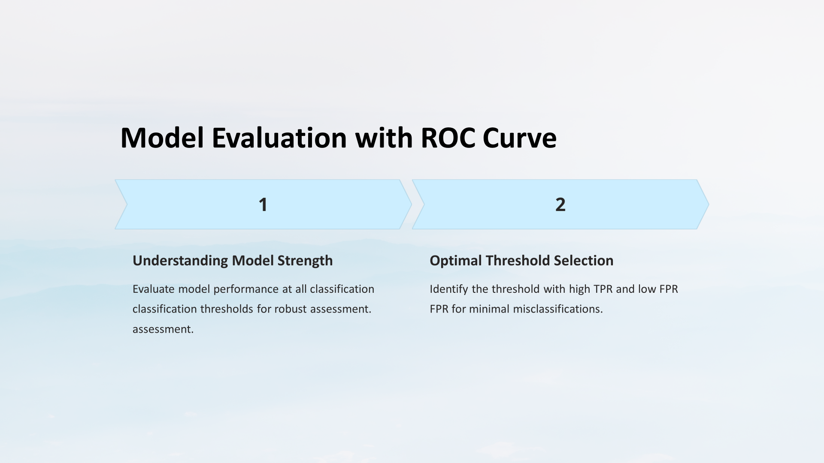

Slide 21
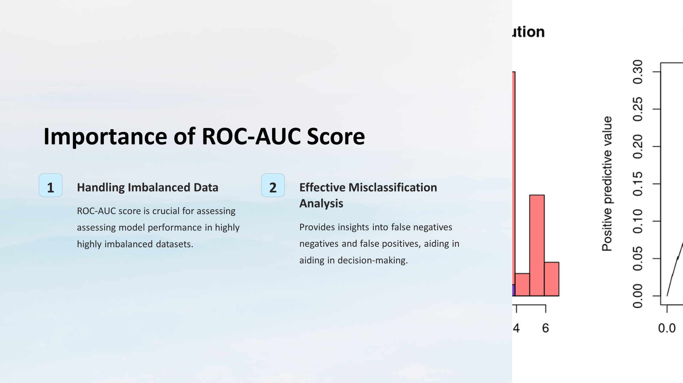

Slide 22
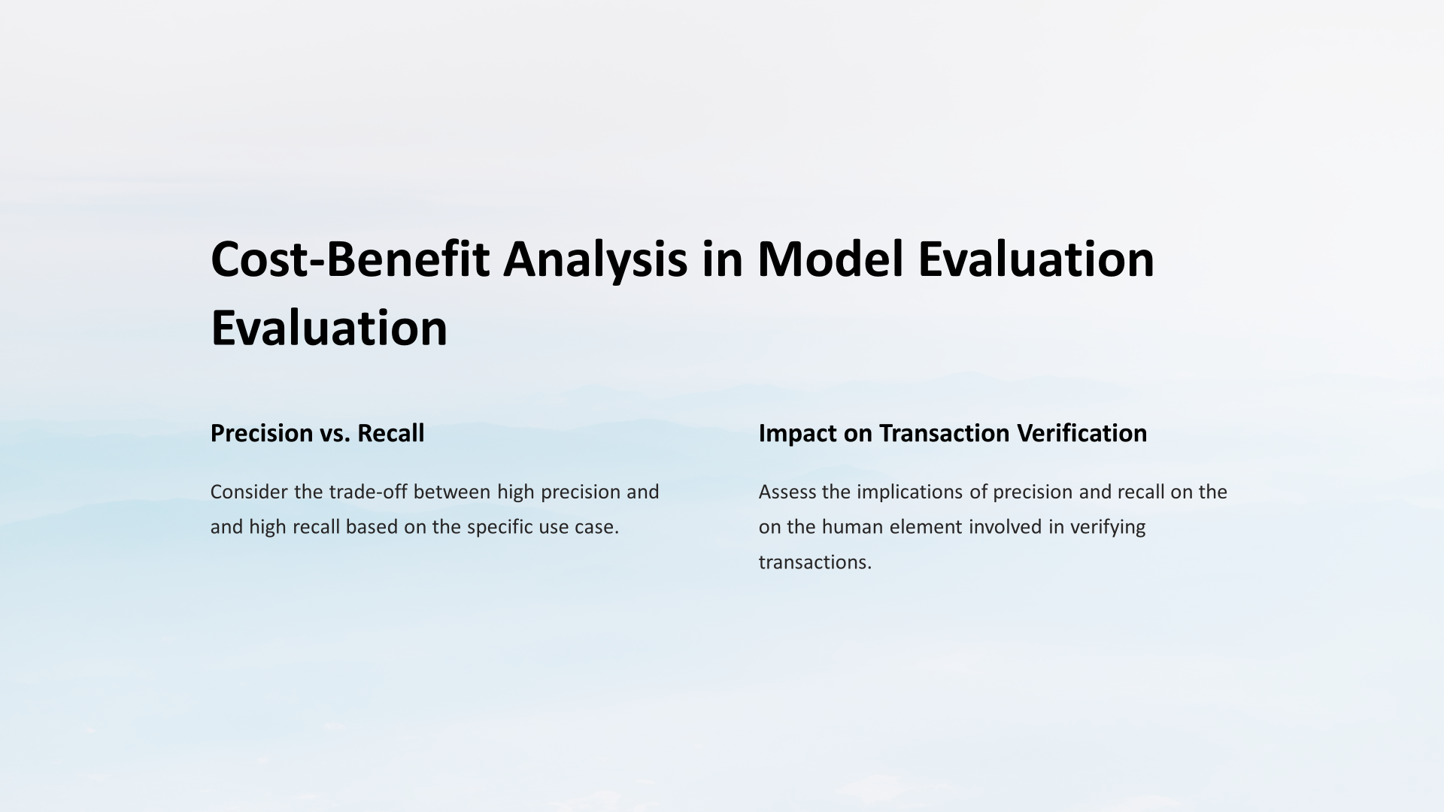

Slide 23
import pandas as pd
# Assuming your train and test datasets are named 'train_data' and 'test_data'
train_data['trans_date_trans_time'] = pd.to_datetime(train_data['trans_date_trans_time'])
train_data['month'] = train_data['trans_date_trans_time'].dt.month
average_transactions_per_month_train = train_data['month'].value_counts().mean()
fraudulent_transactions_train = train_data[train_data['is_fraud'] == 1]
average_fraudulent_transactions_per_month_train = fraudulent_transactions_train['month'].value_counts().mean()
average_amount_per_fraudulent_transaction_train = fraudulent_transactions_train['amt'].mean()
print("Train Data:")
print("Average Transactions per Month:", average_transactions_per_month_train)
print("Average Fraudulent Transactions per Month:", average_fraudulent_transactions_per_month_train)
print("Average Amount per Fraudulent Transaction:", average_amount_per_fraudulent_transaction_train)
print()

Slide 24
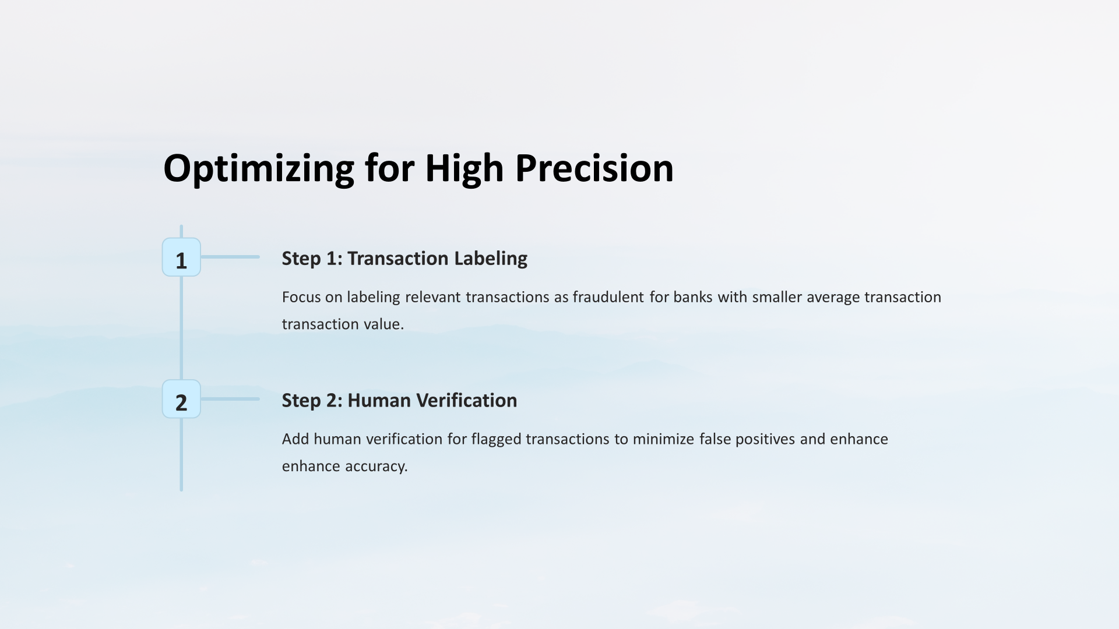

Slide 25

Conclusion:
1
Model Effectiveness
2
Possible Improvements
The report concludes that the random model can effectively detect credit card fraud transactions with high accuracy and low false positives.
It also suggests some possible improvements and future work, such as using more data, applying more advanced techniques, and deploying the model in a real-time system.

